Slide 1

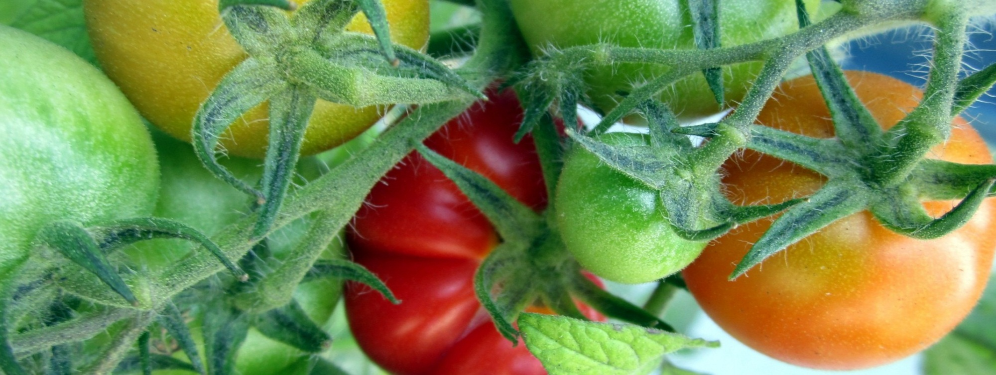
Minimal Transportation Simulation

Slide 2


Minimal Transportation Simulation
Alexis Pibrac
Internship Feb-May 2016

Slide 3


Pr. Chen Jianghang
PR. WANg Xiaolei
Pr. Chen Jianghang
PR. WANg Xiaolei
Pr. Bilal farooq
Alexis pibrac

Slide 4
Plan
Presentation of the study
The simulation tool
Some results
What’s next

Slide 5
Plan
Presentation of the study
The simulation tool
Some results
What’s next

Slide 6








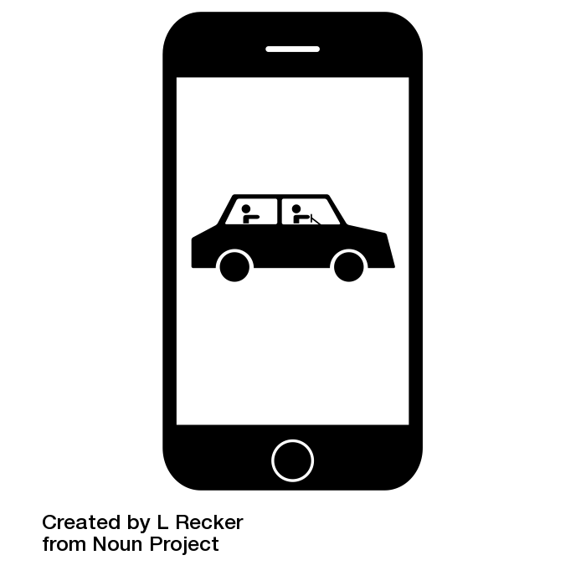

The dynamic transportation systems
Static
dynamic
Personal cars
Metro/subways/bus/train
Walk/bike
Taxi
Uber style
Ridesharing
Carsharing
Driverless car float?

Slide 7
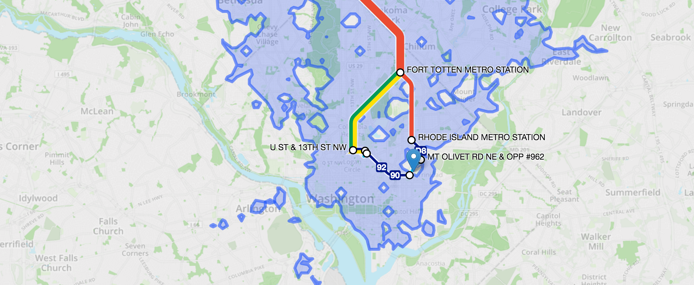
Transportation simulations

Slide 8
Transportation simulations
Number of users
Efficiency
Price
Side effects
Vehicule kilometers travelled saving
…

Slide 9
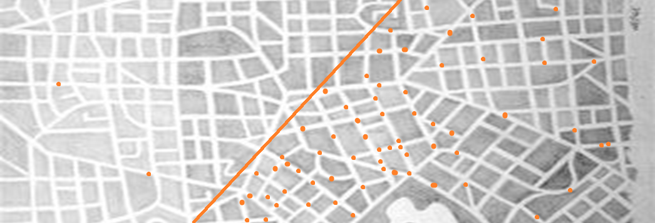
Dynamic transportation systems
The efficiency depends on the number of users.

Slide 10
Dynamic transportation systems
The installation and efficiency are dynamic.
Efficiency
Users

Slide 11
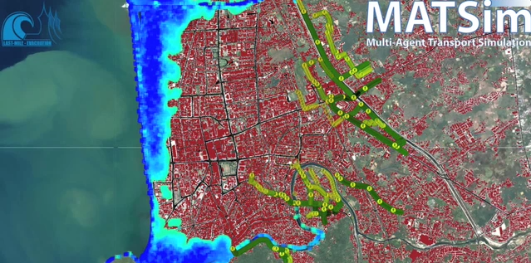
Transportation simulations
…already exist
But designed for STATIC modes, can’t accept DYNAMIC ones.

Slide 12
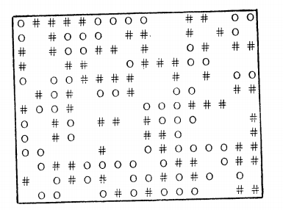
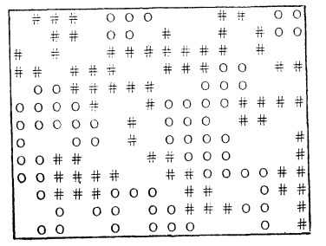
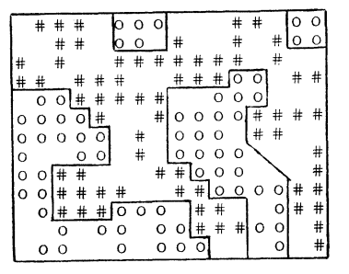
The Schelling approach
« Dynamic models of segregation », 1971

Slide 13
The Schelling approach
Segregation is
Analysed at a macroscopic level
Dependant on the network
Dependant on individual behaviors

Slide 14
The Schelling approach
Segregation is
Dynamic transportation system efficiency is
Analysed at a macroscopic level
Dependant on the network
Dependant on individual behaviors
Analysed at a macroscopic level
Dependant on the network
Dependant on individual behaviors

Slide 15

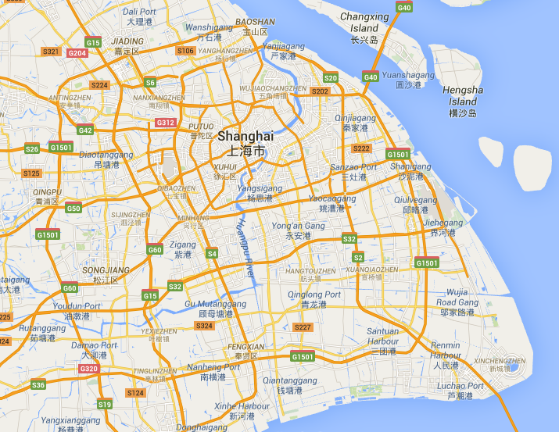
Our approach

Slide 16

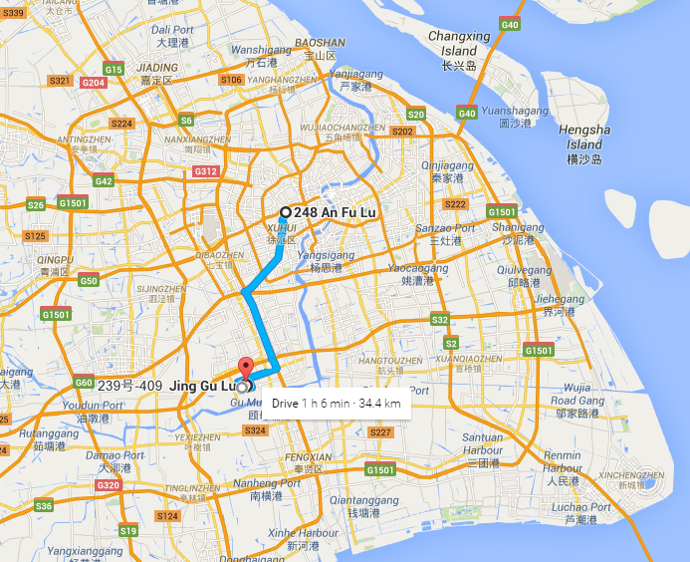
Our approach

Slide 17
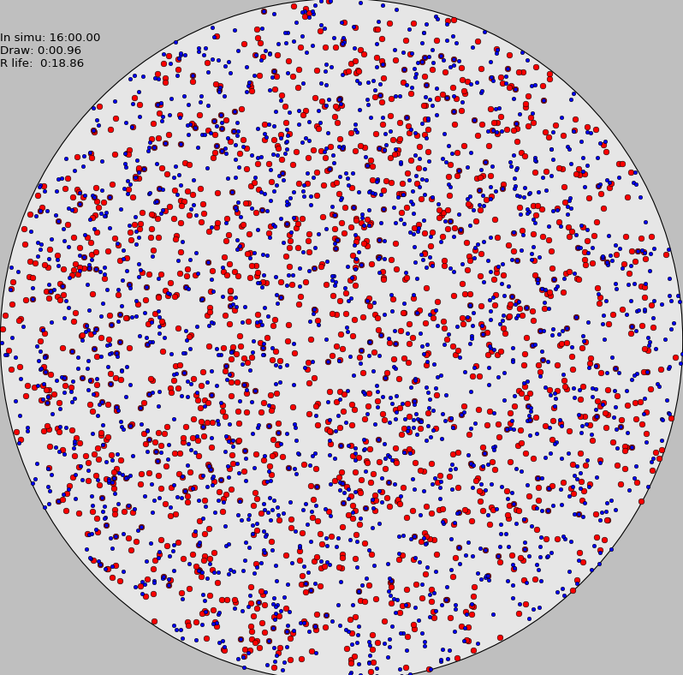
Our simulation

Slide 18
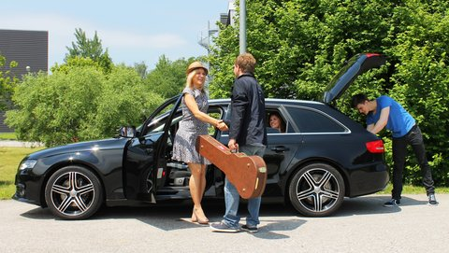

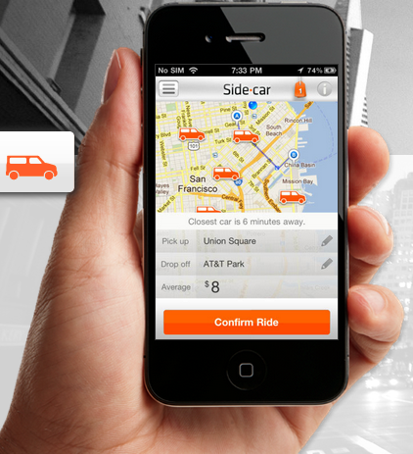


Chosen transportation system: Dynamic Ride-Sharing

Slide 19
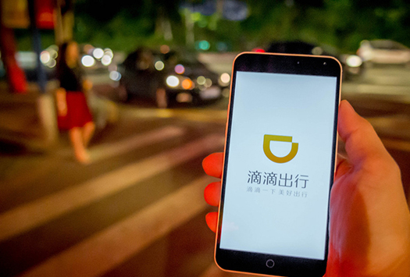




Chosen transportation system: « Shanghai platform »
Time

Slide 20
Plan
Presentation of the study
The simulation tool
Some results
What’s next

Slide 21
The tool
In Python
Agent based
Discrete event simulation

Slide 22
The tool
In Python
Agent based
Discrete event simulation
Event 1
Event 2
Event 4
Event 3
…

Slide 23
The tool
In Python
Agent based
Discrete event simulation
Event 1
Event 2
Event 4
Event 3
…
Event 3b
Event 5

Slide 24
The tool
In Python
Agent based
Discrete event simulation
Event 1
Event 2
Event 4
Event 3
…
Event 3b
Event 5

Slide 25
The tool
In Python
Agent based
Discrete event simulation
Event 1
Event 2
Event 4
Event 3
…
Event 3b
Event 5
Event 4b
Event 4t

Slide 26
The tool
Core
System’s functions
Matching Platform
One kind of dynamic system + description of agents
Execution of Simulations
Config.py (parameters)
Execution
Particular functions to prepare the simulation
Graphs and display tools

Slide 27
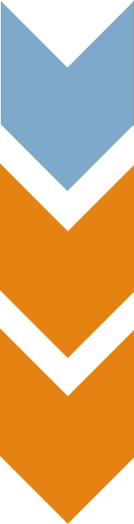
The tool: Core
Simulation
- list of events
- run
Event
- time
- execution
Agent
Story

Slide 28
The tool: Core
Simulation
- list of events
- run
Event
- time
- execution
Platforfm
Events
Agent
Story
Agents

Slide 29
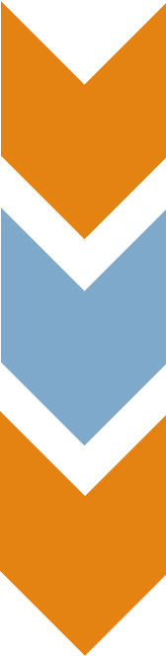
The tool: matching platform
PublishAnnounce
Platform
PublishAnnounce
Passenger
List
WatchAnnounce
Check
Compatibility
Evaluation
Driver
Choice
StartTravel

Slide 30
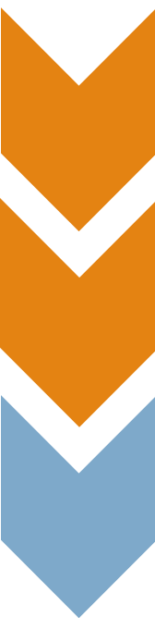
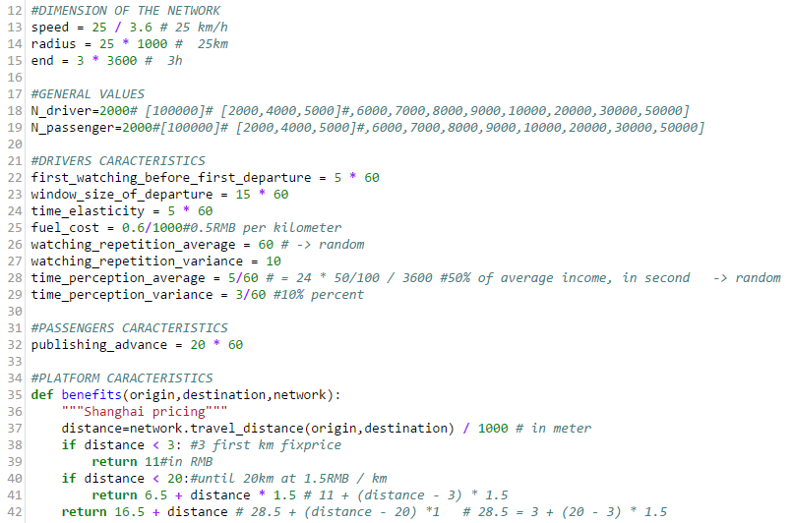
The tool: Parameters
Config.py

Slide 31
Plan
Presentation of the study
The simulation tool
Some results
What’s next

Slide 32
Basic simulations
Time = 3h
Radius = 25km
Perceived speed = 25km/h
20 000 drivers
20 000 passengers
Shanghai’s fuel cost and ride price

Slide 33
Platform reliability and efficiency
Several simulations launched with different parameters

Slide 34
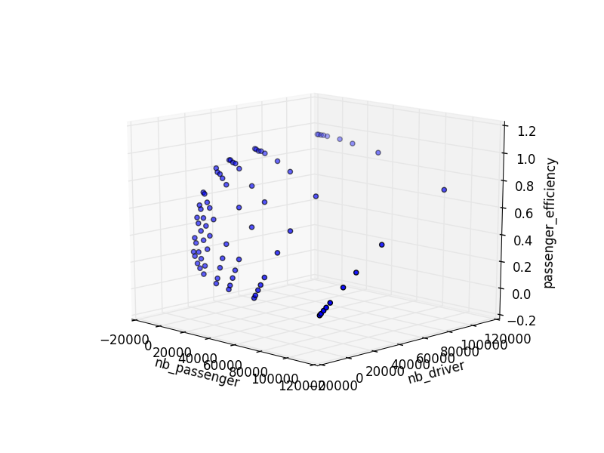
Reliability
against
Number of users

Slide 35
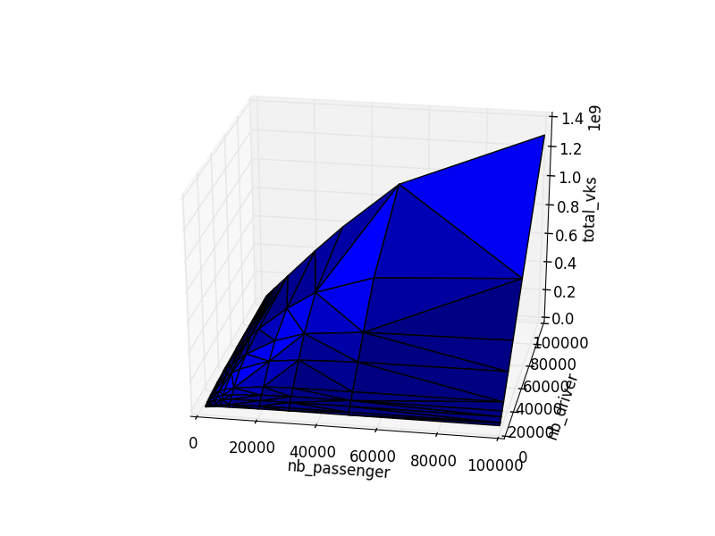
Vehicule kilometers traveled saving
against
Number of users

Slide 36
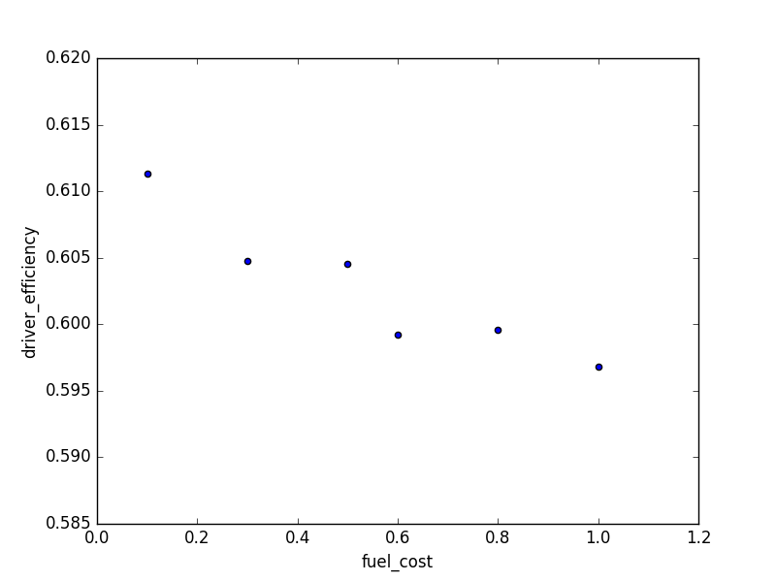
Reliability
against
Fuel cost
Notes:
More !

Slide 37
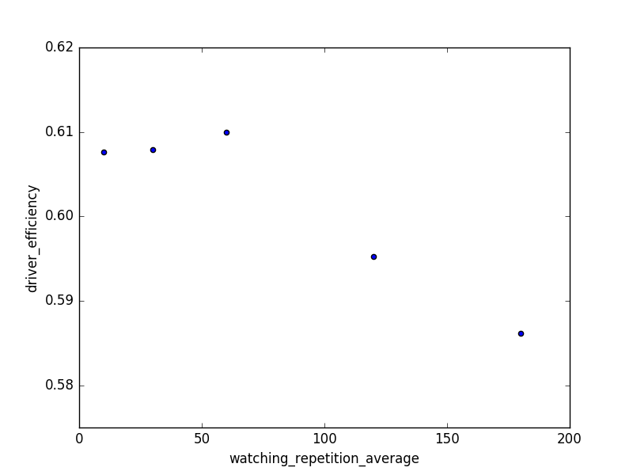
Reliability
against
Average watching tempo
Notes:
MORE SIMULATIONS !

Slide 38
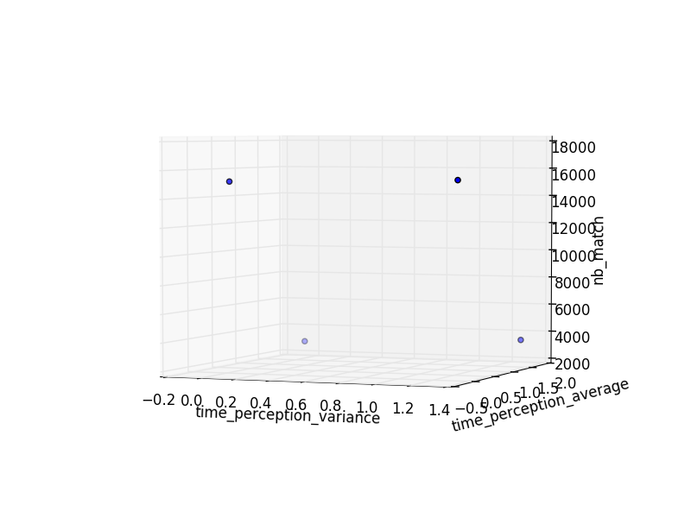
Number of matches
against
Driver’s value of time
Notes:
More points

Slide 39
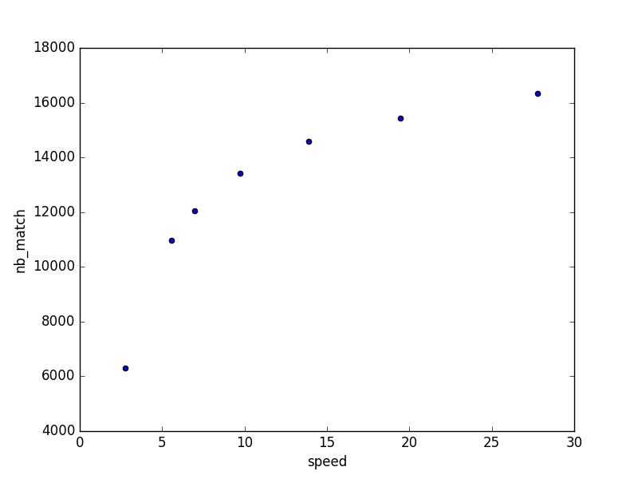
Number of match
against
Average speed
Notes:
More points

Slide 40
Customer analysis
One simulation analysed
Different customers are compared

Slide 41
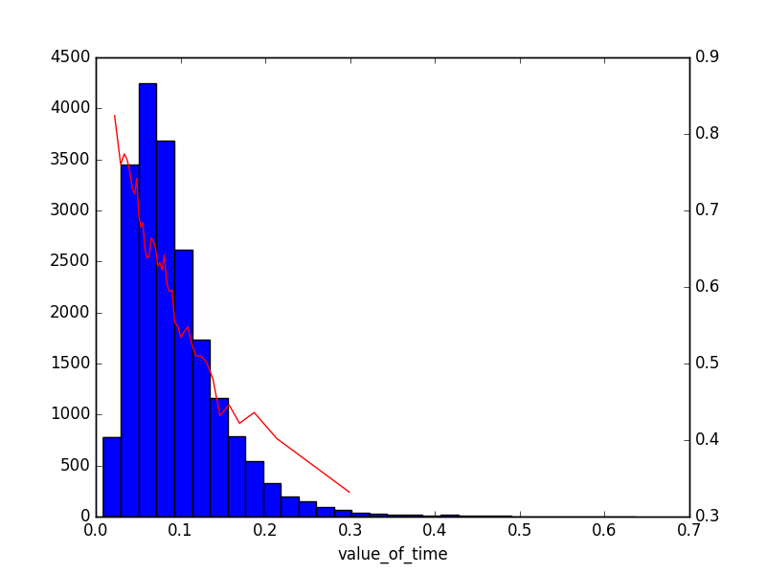
Reliability for a driver
against
Driver’s value of time

Slide 42
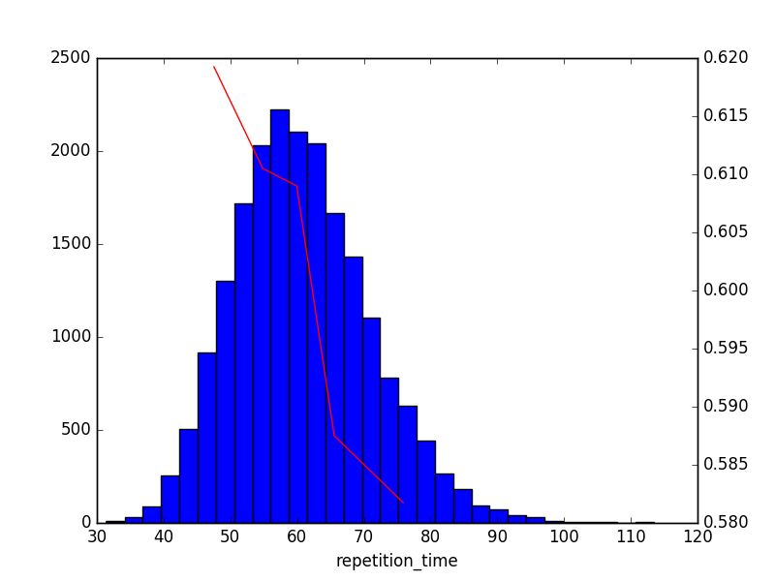
Reliability for a driver
against
Driver’s watching tempo
Notes:
0 to 200

Slide 43
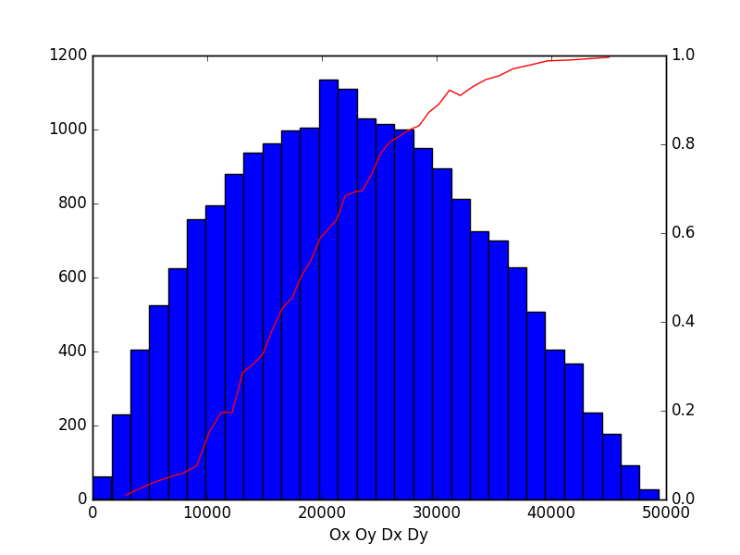
Reliability for a driver
against
Driver’s trip length
Notes:
Change the colors
Bigger red

Slide 44
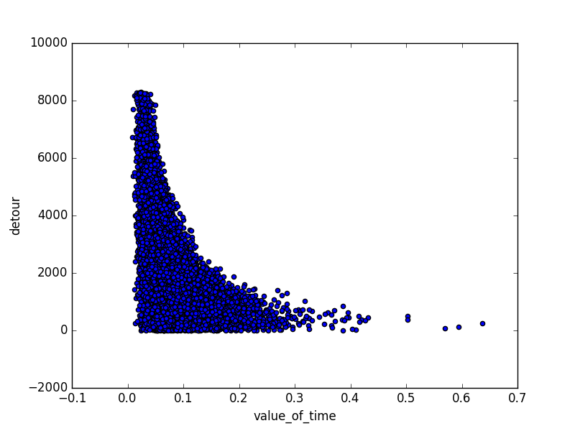
Detour
against
Driver’s value of time

Slide 45
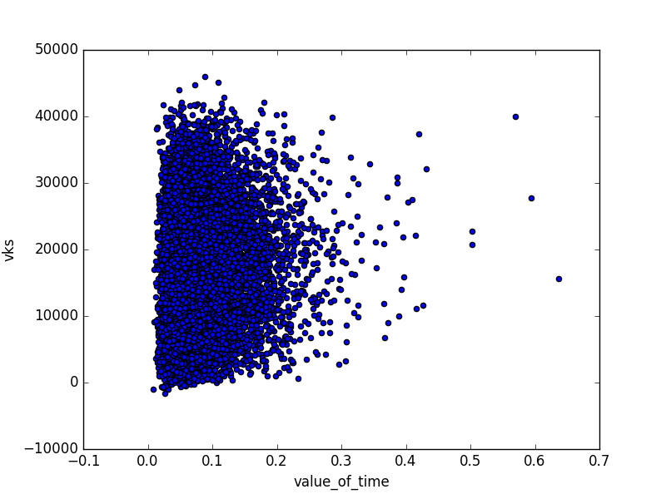
Vehicule kilometer traveled saving
against
Driver’s value of time
Notes:
See Average

Slide 46
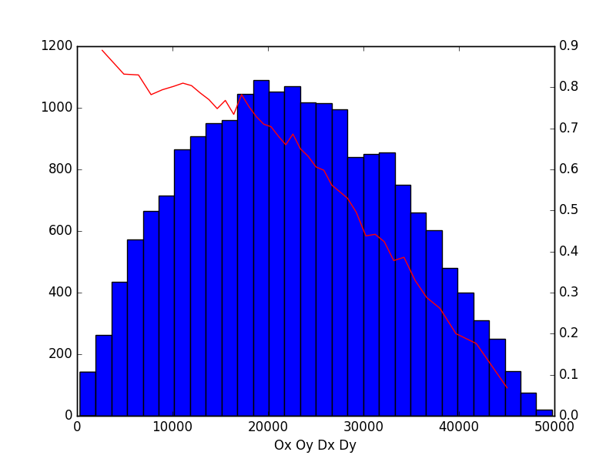
Reliability for a passenger
against
Passenger’s trip length

Slide 47
Reliability against trip length
Drivers
passengers

Slide 48
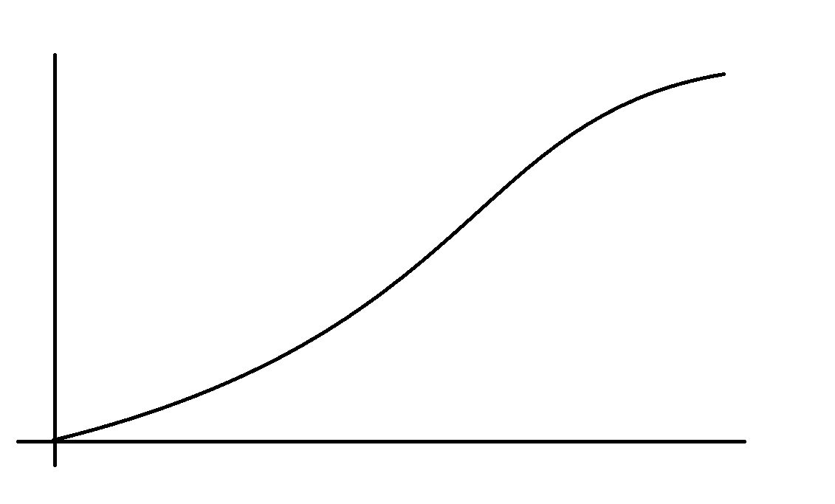
Interpretation
Goal:
Efficiency VS number of users
Efficiency VS incentives
…

Slide 49
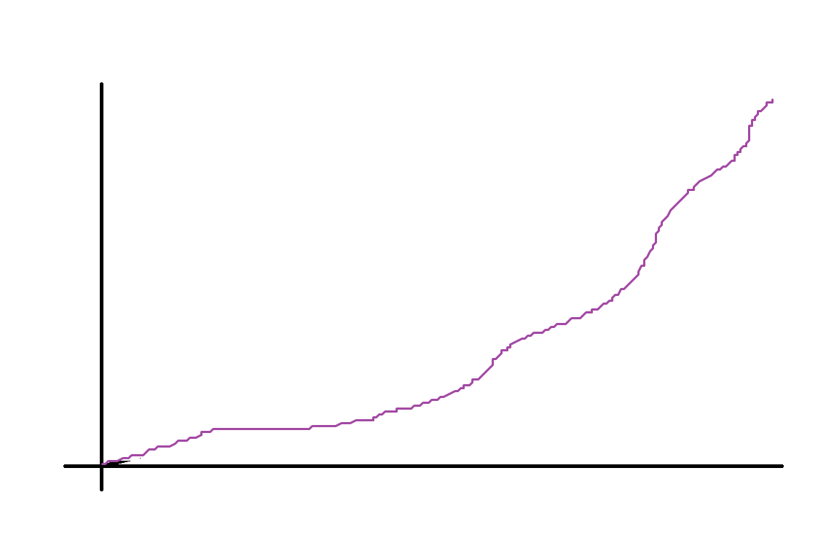
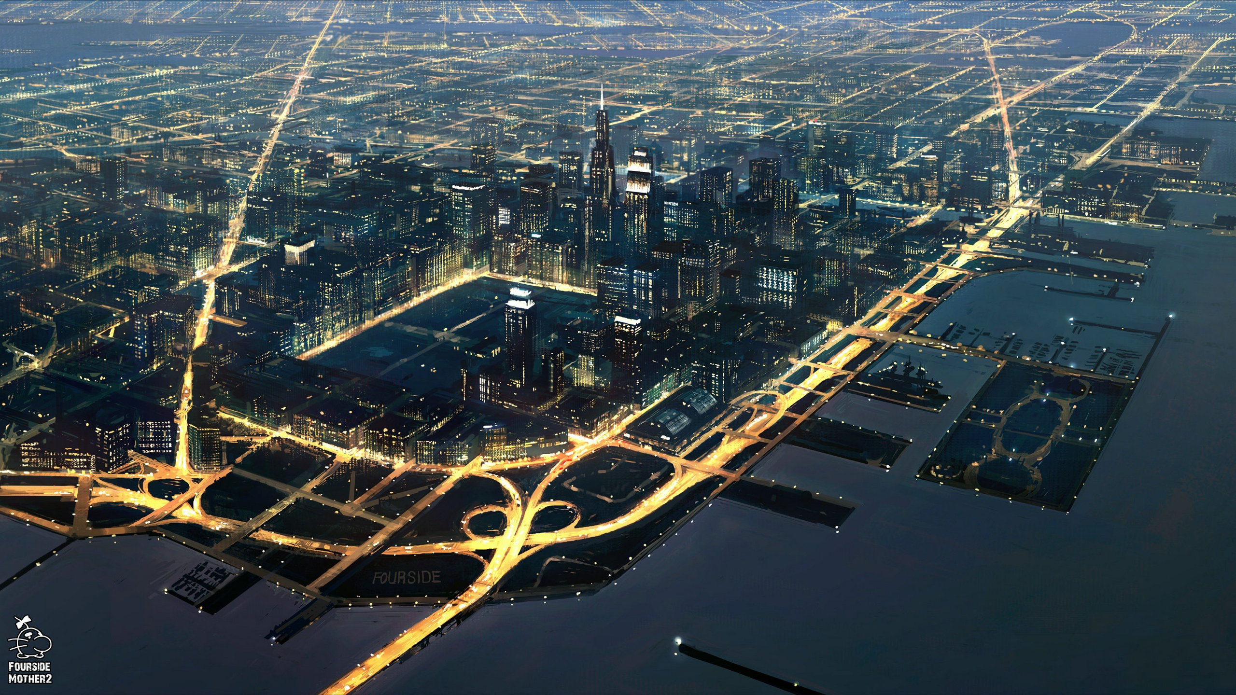
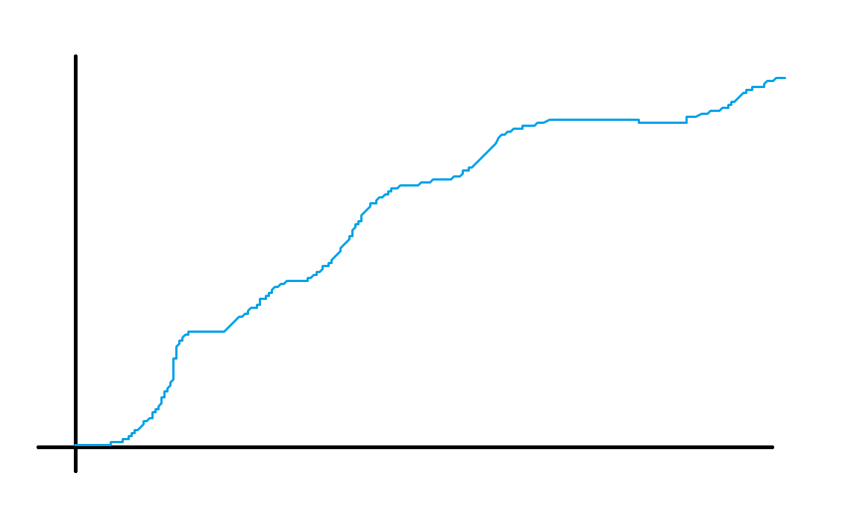

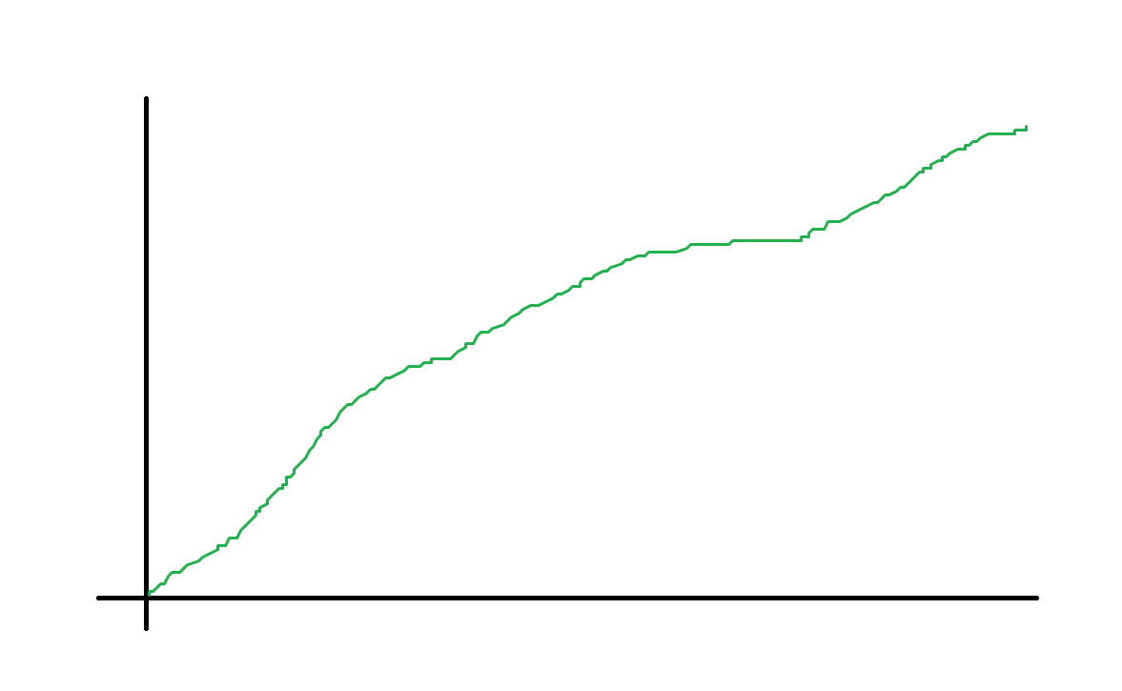
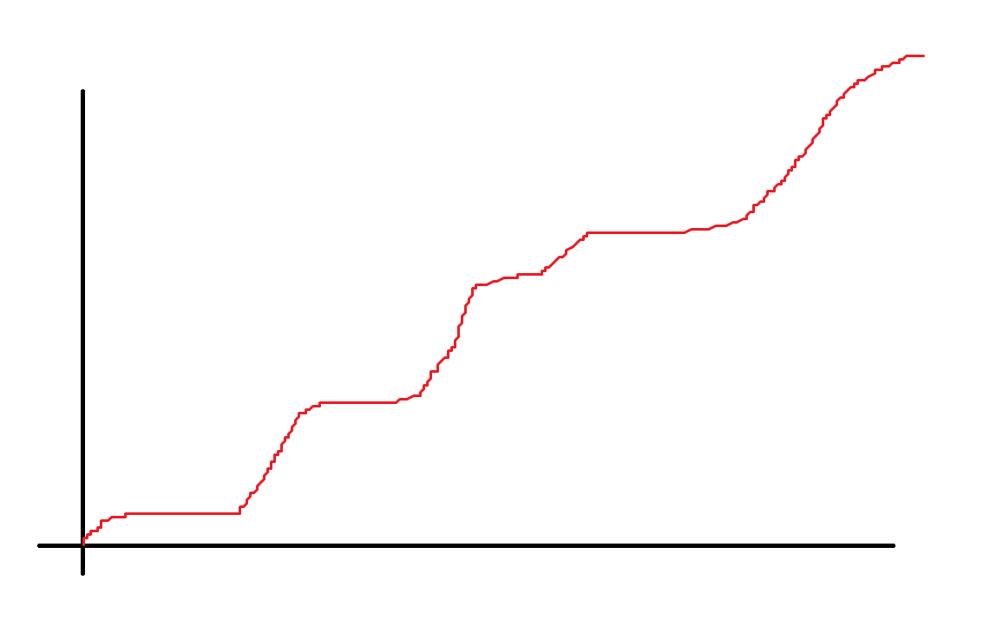
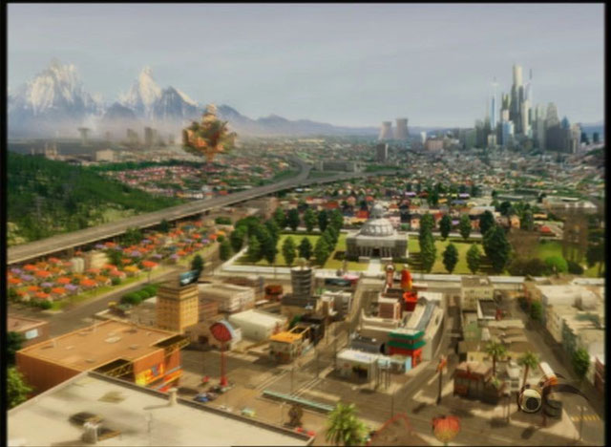
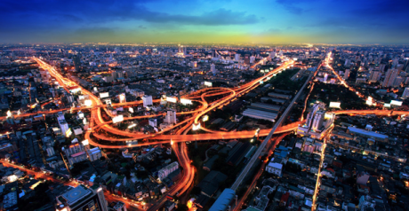
Interpretation
Relation depends on (System + network)

Slide 50
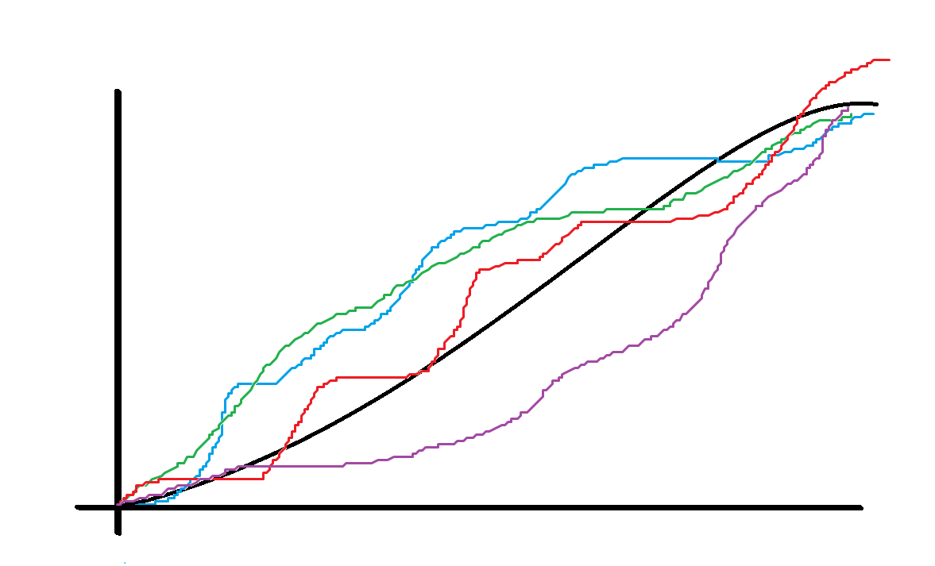
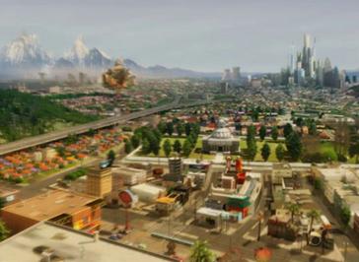

Interpretation
There is a particular law for the system (using only some average network particularities).

Slide 51
Plan
Presentation of the study
The simulation tool
Some results
What’s next

Slide 52
With the « Shanghai platform »
More simulations – more different scenarios – more analysis
Fit the curves
Spot and analyse unexpected effects

Slide 53
New platforms
Implement and test new platforms
Improve the realism and utility of the tool

Slide 54

Thank you for your attention

Slide 55
Thank you for your attention
Alexis.pibrac@gmail.com

